Slide 1

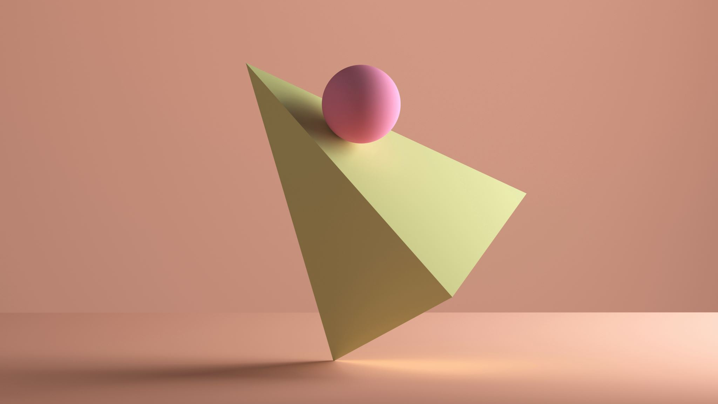
STACK
Nature and Implementation
Martzel P. Baste

Slide 2
Intended Learning Outcomes
At the end of the lesson, the students are expected to:
Explain the definition and importance of Stack Algorithm
Identify Stack basic operations
Implement ADT Stack using array-based structure
Examine the application of ADT Stack

Slide 3


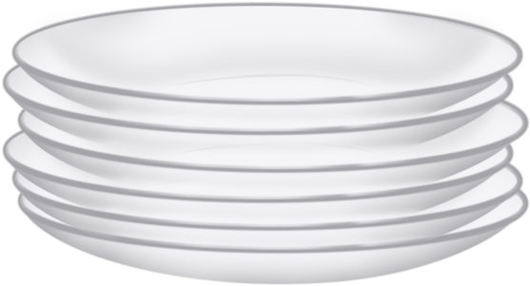
Stacks: Nature
It is a linear list in which all additions and deletions are restricted to one end called TOP.
LAST-IN FIRST-OUT (LIFO)
Examples:
  Stack of Coins
  Stack of Dishes

Slide 4


Why Study Stacks?
Stack applications can be classified into four broad categories:
  Reversing data
  Parsing data
  Postponing data usage
  Backtracking steps

Slide 5

Reversing Data
Reversing data requires that a given set of data be reordered so that the first and last elements are exchanged.
Example:
Reverse a list of numbers
    Input : 1 2 3 4 5
    Output : 5 4 3 2 1

Slide 6

Parsing
Parsing is any logic that breaks data into independent pieces for further processing.
  Example: To translate a source program into machine language, a compiler must parse the program into individual parts such as keywords, names, and tokens
  Example: parsing parenthesis () – to make sure all opening-closing parentheses are paired

Slide 7

Postponement
Often the logic of an application requires that the usage of data be deferred until some later point
Examples:
  Infix to Postfix Transformation
  Postfix evaluation
Prefix : + ab
Postfix : ab +
Infix : a + b

Slide 8
Backtracking
This is another stack use that is found in applications such as computer gaming, decision analysis, and expert systems.
Goal seeking
Eight queens problem

Slide 9

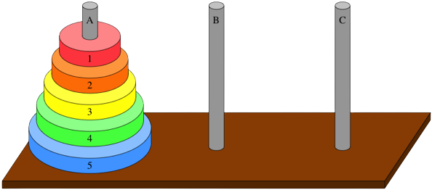
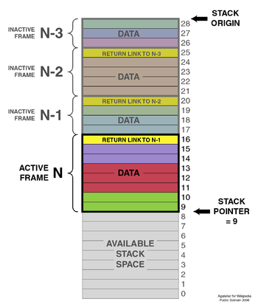
Other Applications
https://www.khanacademy.org/computing/computer-science/algorithms/towers-of-hanoi/a/towers-of-hanoi
https://www.mathsisfun.com/games/towerofhanoi.html
Notes:
https://www.khanacademy.org/computing/computer-science/algorithms/towers-of-hanoi/a/towers-of-Hanoi
https://www.mathsisfun.com/games/towerofhanoi.html

Slide 10
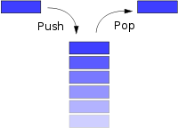
Basic Operation
Push
Adds an item at the top of the stack
Pop
Removes an item at the top of the stack and returns it to the user
Stack Top
Copies the item at the top of the stack. It returns to the user the data in the top element but does not delete it.

Slide 11
PUSH Operation
Data
PUSH
Top
Operation
Top

Slide 12
POP Operation
Data
POP
Top
Operation
Top

Slide 13
STACKTOP Operation
Data
Stack Top
Top
Operation
Top

Slide 14
Properties
Adding element: O(1)
deleting element: O(1)
Accessing Time: O(n) [Worst Case]
Only one end allows inserting and deleting an element.

Slide 15
THANKYOU!

